Slide 1
Machine Learning-MINI PROJECT
Face Position Detection Using
ML Algorithms
Name: Karavadi Tejesh
Roll No: 1901087

Slide 2
Problem Definition
Face Position detection Task Has To Used In This Problem For detecting the head position of driver While Driving in Real scenarios Based On The Features of The Given Driv - Face Dataset.
These positions are Classified Into 3 Classes 1-looking-Right(lr), 2-Frontal(f), 3-looking-Left(ll).
Modeled as a multi-Class classification problem.
Associated Tasks: Classification

Slide 3
Introduction:
Over the past several years, Face Position Detection remains an attractive research topic, since it is still challenging due to the diversity of the head appearance caused by the head motion and various head pose changes, such as 10 facial texture, inhomogeneous illumination, Partially Occlusion.
A Number of algorithms have been proposed to address This Problem. In This Project, We Try To Solve This Problem By using Machine Learning Algorithms.
Face plays a core part in distinguishing and identifying a person and hence face detection is much sought after.

Slide 4
Abstract:
LITERATURE SURVEY
We rely on a set of geometric features computed from just three representative facial Keypoints. The Method has a confidence mechanism to decide the reliability of a sample label.
We rely on a set of geometric features computed from just three representative facial Keypoints, namely the center of the eyes and the nose tip.
With these geometric features, our method combines Classification Algorithms In Machine Learning For The Classification Of The Images To The Respective Classes. In addition, the method has a confidence mechanism to decide if the classification of a sample is not reliable.
The low computational cost of the method and its robustness makes feasible to integrate it in massive consume devices as a real time application.

Slide 5
Why use ML?
Here The Input-Output Relation Is Not Straight Forward.
So, Here We Can Design a Model Using Algorithms In ML Such That, By Passing The Different Training Samples from The Dataset and Make The Model Learn From The Experience.
The Model Should Correctly Detect The Respective Class By Using Features Of the Face From The Dataset and Classify The Images Into Corresponding Classes.
We Use Some ML Algorithms Like “LOGISTIC REGRESSION”,”SINGLE LAYER PERCEPTRON(SLP)”,”MULTI LAYER PERCEPTRON(MLP)”.For The Task And Calculate The Accuracies for The Classification.

Slide 6
RELATED WORK :
The classification methods learned a mapping between images and a discretized space of poses. Given a new image, the classifiers assign it to a discrete class .
Since the majority of such methods have discretized outputs, only allowing coarse head pose estimation, it is difficult to derive a reliable continuous estimation from the results.
Different from classification methods, regression methods estimate Face Position by learning a functional mapping from the image space to one or more pose directions .
The allure of these approaches is that with a set of labeled training data, a model can be built to provide a precise Face Position estimation for any new data samples. Due to the breakthrough results achieved by Machine learning technologies in many research field.
Zavan et al. proposed an automatic pipeline based on convolutional neural networks for detecting different facial regions, processing them, and combining the results generated from each, resulting in a robust head pose estimation and gender recognition. And some recent work can estimate head pose with high accuracy and perform in real time.

Slide 7
The 3 facial Keypoints, corresponding to the center of both eyes and the nose tip, are enough to extract 10 geometric features based on angles and Euclidean distances and obtain accurate and precise results for both coarse and fine head pose estimation.
This is probably due to the fact that nose tip and eyes are fixed parts of the face so that their degrees of freedom are closely linked to the same degrees of freedom as the face.
Indeed, mouth state information could serve to detect driver fatigue, but only the edges might not be enough to report a robust state of the mouth and detect events like yawning.
Besides, our method has proven its robustness, maintaining a high accuracy in noisy detections up to 4 pixels for all directions. Several factors such illumination changes can hinder this robustness, misleading proper outputs in some frames.

Slide 8
APPLICATIONS:
DRIVER Behaviour is the most important factor for on-road driving safety. Since humans are the major users of roads, their driving Behaviours influence traffic safety and Efficiency. So, For Driver Monitoring We Can Use Face Position Detection
Intelligent Wheel Chair Systems
Surveillance systems
Human-Robot Interactions
.

Slide 9
Dataset Description:
The Driv-Face Database contains images sequences of subjects while driving in real scenarios. It is composed of 606 samples of 640Ã—480 pixels each, acquired over different days from 4 drivers (2 women and 2 men) with several facial features like glasses and beard.
A set of labels assigning each image into 3 possible gaze direction classes are given. The first class is the looking-right class and contains the head angles between -45Âº and -30Âº. The second one is the frontal class and contains the head angles between -15Âº and 15Âº. The last one is the looking-left class and contains the head angles between 30Âº and 45Âº.
Along with the facial key point positions(eyes, nose and mouth).
No Of Patterns Given =606
No Of Features Given =18
After Removing Some Useless Features From The Dataset, The Dataset Contains Total 14 Features
.

Slide 10
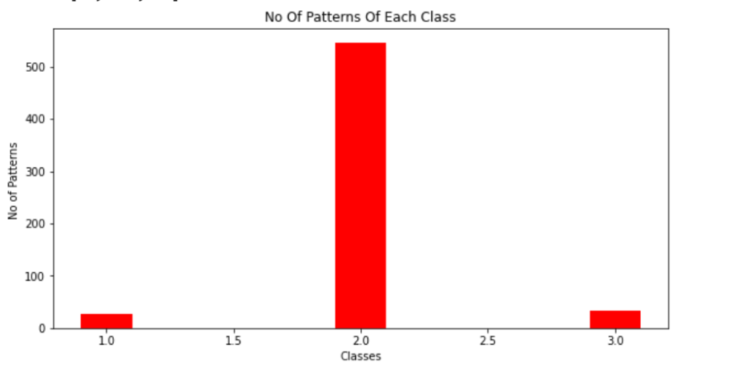
The Given Dataset Is Highly Imbalanced,The Provided Dataset Contains Class Imbalance Problem.The No of Patterns For Each of The Given 3 Classes-{1,2,3} are:
Class 1=27 Patterns, Class 2=546 Patterns, Class 3=33 Patterns.
As We Can See In The Bar Graph Also, That Patterns Belong To Class 2 Were High Compared To Remaining 2 Classes.

Slide 11
Results Analysis
For The Given Face Position Detection Task , Applied The ML Classification Algorithms
1)Logistic Regression
By Using MSE Cost-Function:
By Hyper-Parameter Tuning On The Validation Set, Best Hyper Parameters are
Alpha=0.1,Rho=0.0001,Epochs=10.
After Training The Model, Using 30% of The Samples
Correctly Predicted : 153
Total Test Samples : 181
confusion Matrix= [[0 14 0]
[0 153 0]
[0 14 0]]
Train Accuracy: 84.51270718232044

Slide 12
After The Training Is Completed, Testing The Model By Using The Test Set:20% of The Samples
Correctly Predicted : 53
Total Test Samples : 59
confusion Matrix= [[0 2 0]
[0 53 0]
[0 4 0]]
Test Accuracy: 89.43697478991596
As The Dataset Is Class Imbalanced, Predicton of The Model Is Biased Towards The Class 2
Applying Kfold- Cross Validation by Using K=5
Accuracies Fold Wise:
Fold 1: Accuracy : 90.98360655737704
Fold 2: Accuracy : 92.56198347107438
Fold 3: Accuracy : 89.25619834710744
Fold 4: Accuracy : 90.9090909090909
Fold 5:Accuracy : 86.77685950413223
Average Accuracy: 90.0975477577564

Slide 13
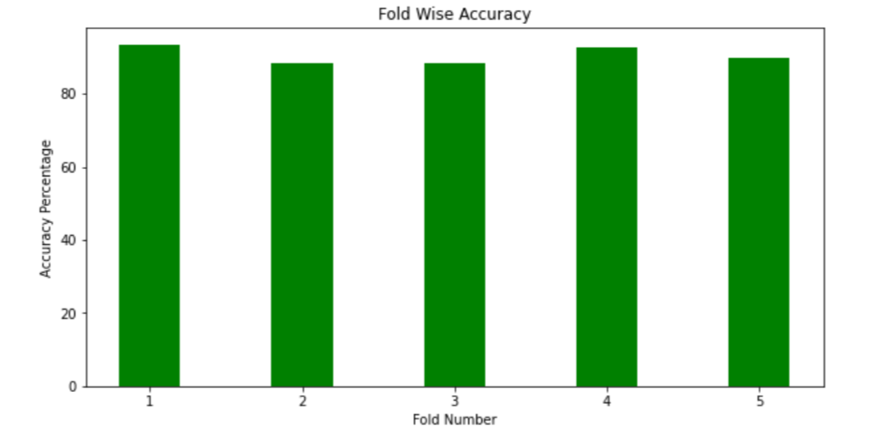
Random initialization of weights and random assignment of samples to train and test Sets,Bar Graph After Applying The Kfold Accuracy For Logistic Regression
ALL 5 FOLD Accuracies were More Than 85%

Slide 14
Using LoggLoss(Convex)-Cost Function:
By Hyper-Parameter Tuning On The Validation Set, Best Hyper Parameters are Alpha=0.001,Rho=0.0005,Epochs=80.
After Training The Model:
Train Accuracy : 90.60773480662984
After The Training Is Completed, Testing The Model By Using The Test Set:20% of The Samples
Test Accuracy : 91.52542372881356
For The Class Imbalance Problem,After Doing The UnderSampling, By Reducing the Size Of The Classes
The Accuarcy is 70.45454545454545..Which Is Low, Because of The Reduction in No Of Samples Of Each Class.
After Oversampling, By Increasing The Size Of The Classes,
The Accuracy is 81.56288156288156 Which is High Compared To Undersampling.

Slide 15
2)SINGLE-LAYER PERCEPTRON(SLP):
Uses The Concept Of ANN and Performs Classification Using One Architecture By Performing One-Hot Encoding On The Dataset. Used Inbulit From SKlearn
Accuracy = 90.0990099009901
Confusion Matrix= [[0 12 0]
[0 273 0]
[0 18 0]]
class_accuracy_one= nan
class_accuracy_two= 0.900990099009901
class_accuracy_three= nan
precision for 1 class : 0.0 , recall for 1 class : nan
precision for 2 class : 1.0 , recall for 2 class : 0.900990099009901
precision for 3 class : 0.0 , recall for 3 class : nan

Slide 16
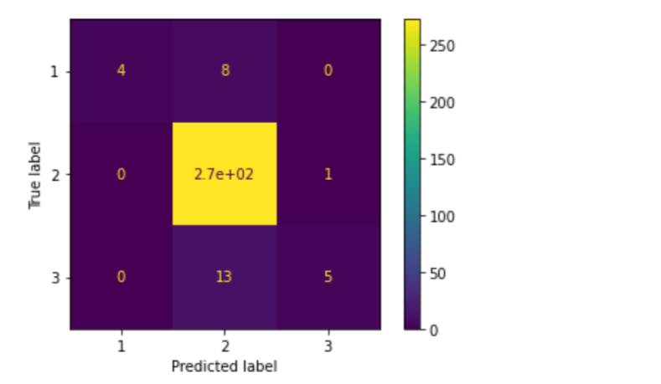
3)MULTI-LAYER PERCEPTRON:
Introducing Multi-Layers In The Architecture For The Classification,Used Inbuilt Function From Sklearn To Implement The Task.
Accuracy For The Classification :93.73927392739274
Confusion_Matrix=[[ 4 8 0]
[0 272 1]
[0 13 5]]
Confusion Matrix For The MLP:

Slide 17
After Applying The Kfold-Validation For The MLP The Accuracies were Like These Below Values
FOLD : 1 accuracy=94.26229508196722
*****************
FOLD : 2 accuracy=92.56198347107438
*****************
FOLD : 3 accuracy= 94.21487603305785
*****************
FOLD : 4 accuracy=93.38842975206612
*****************
FOLD : 5 accuracy=92.56198347107438
*****************
AVG Accuracy :93.39791356184801

Slide 18
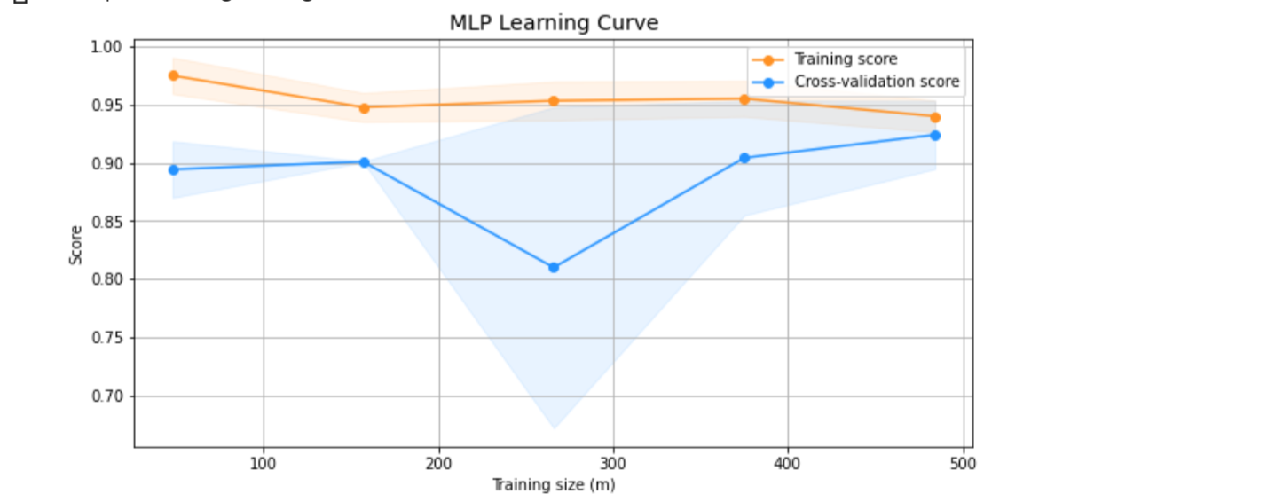
By Plotting The Overfitting Curve,By Plotting The Training And Validation Score the Plot Of The Graph Is Like Below,The 2 Curves Doesn’t Intersect

Slide 19
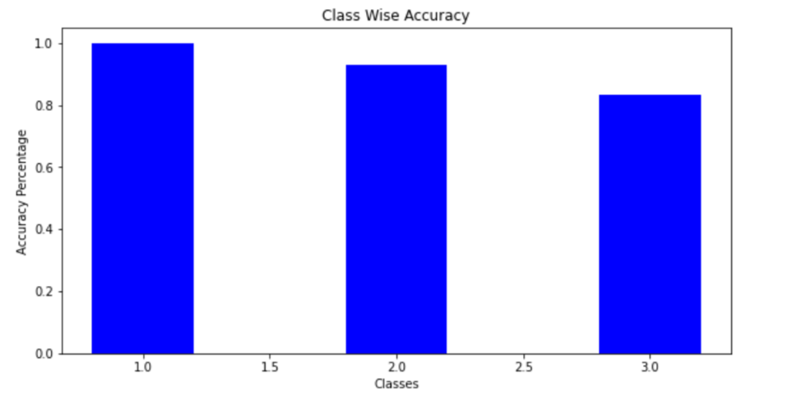
Class Wise Accuracies Of MLP:
Accuracy for Class 1 is Higher Compared To Remaining Classes , From The Bar Graph.
MLP Has Given Best Accuracy I.e 93% When Compared To Remaining Algorithms
Implemented For The Task

Slide 20
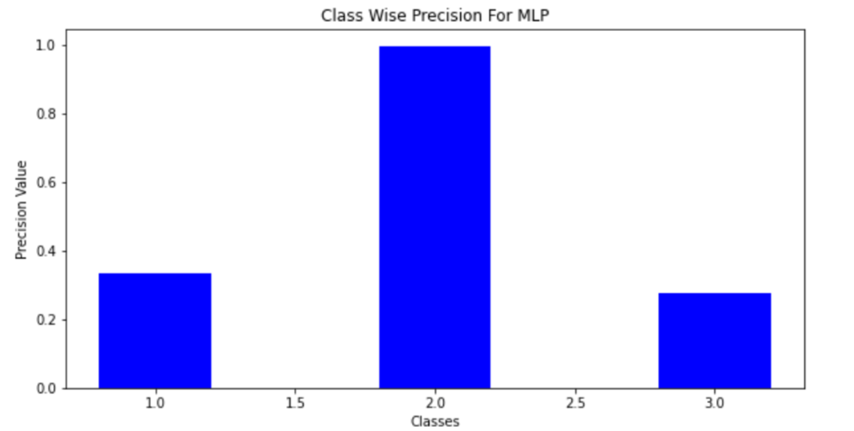
Class Wise Precision Values:
As Precison Value is ,Out of all Positive Predicted samples How many are truly positive.
So, From The Bar Graph We Can See That ,Precison Value For Class 2 is High

Slide 21
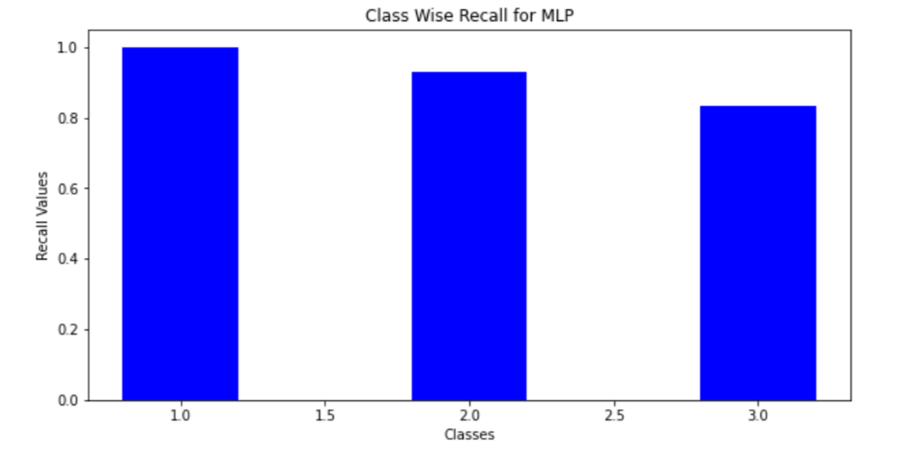
Class Wise Recall Values:
Recall is That,How many of the actual positive cases we were able to predict correctly with our model.
Here,The Recall Value For The Class 1 is More.

Slide 22
References:
Yujia Wang, Wei Liang, Jianbing Shen, Yunde Jia, Lap-Fai Yu, A Deep Coarse-to-Fine Network for Head Pose Estimation from Synthetic Data, Pattern Recognition (2019).
Katerine Diaz-Chito, Jes´us Mart´ınez del Rinc´on, Aura Hern´andez-Sabat´e, Continuous head pose estimation using manifold subspace embedding and multivariate regression, March 2018,IEEE Access PP(99):1-1
Katerine Diaz-Chito, Aura HernÃ¡ndez-SabatÃ©, Antonio M. LÃ³pez, A reduced feature set for driver head pose estimation, Applied Soft Computing, Volume 45.

Slide 23
Thank You…..

